Slide 1
E-commerce
Sales Performance Analysis using PYTHON and SQL

Slide 2
Introduction
Our company is a rapidly growing e-commerce platform serving customers across Brazil, with a presence in over 4,000 cities and achieving 20% year-over-year growth in 2018. We offer a wide range of products—from Health & Beauty to Electronics—connecting customers with sellers through a user-friendly, installment-friendly shopping experience.
While we've successfully expanded our reach and built a strong customer acquisition engine, our next phase of growth is focused on deepening customer relationships and diversifying our operations. By investing in loyalty programs, geographic expansion beyond São Paulo, and a broader, more inclusive seller network, we aim to transform one-time buyers into repeat customers and create a more resilient, sustainable business model.
With strong market potential and a clear roadmap, we are positioned to become a leading player in Brazil’s e-commerce ecosystem.

Slide 3
BASIC PROBLEMS

Slide 4
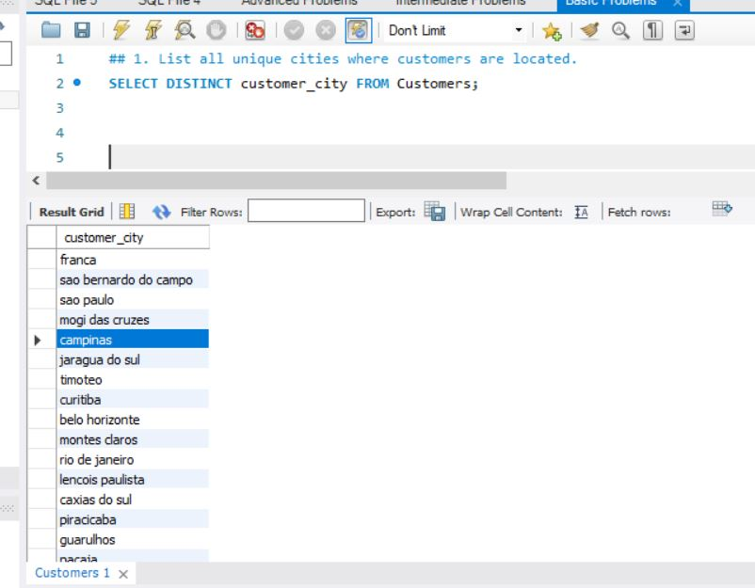
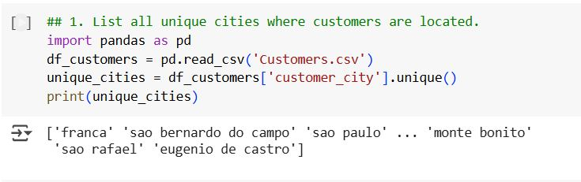
1. List all unique cities where customers are located.

Slide 5
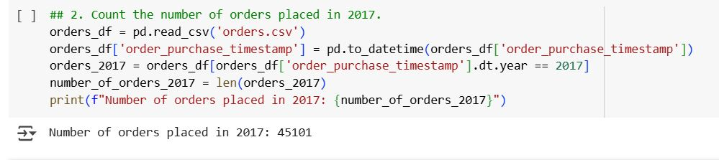
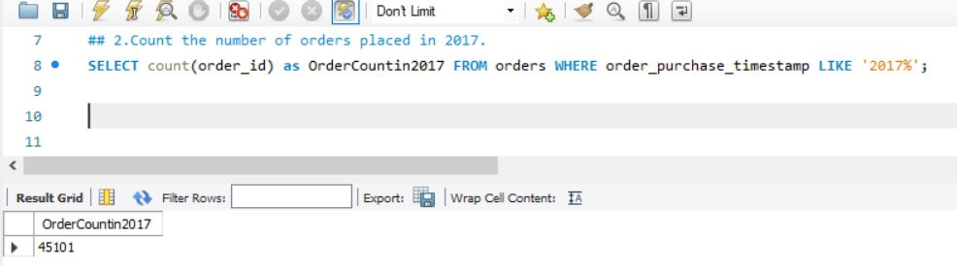
2. Count the number of orders placed in 2017.

Slide 6
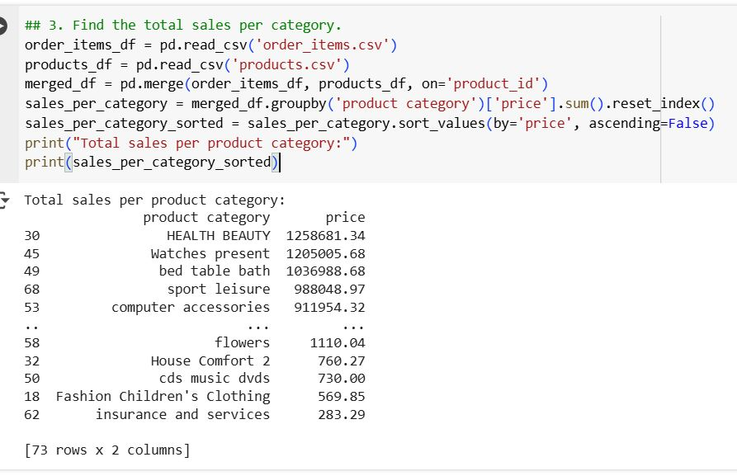
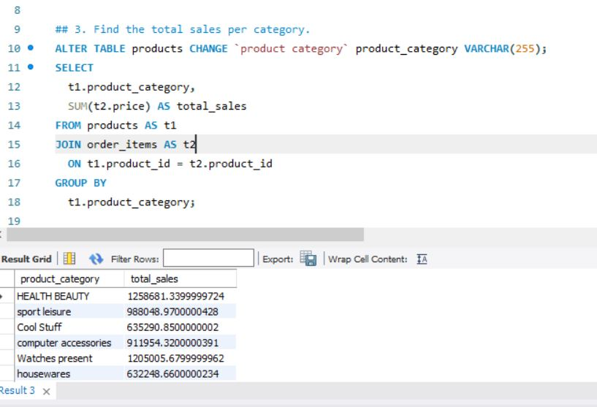
3. Find the total sales per category.

Slide 7
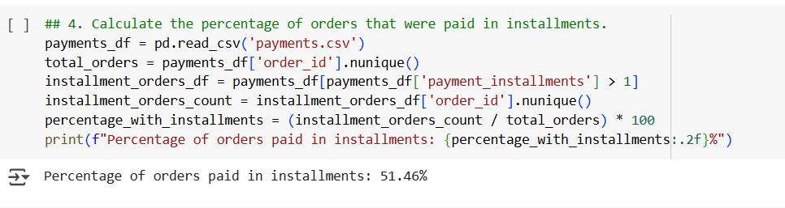
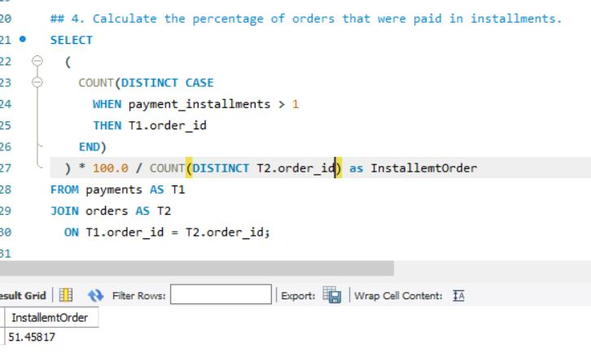
4. Calculate the percentage of orders that were paid in installments.

Slide 8
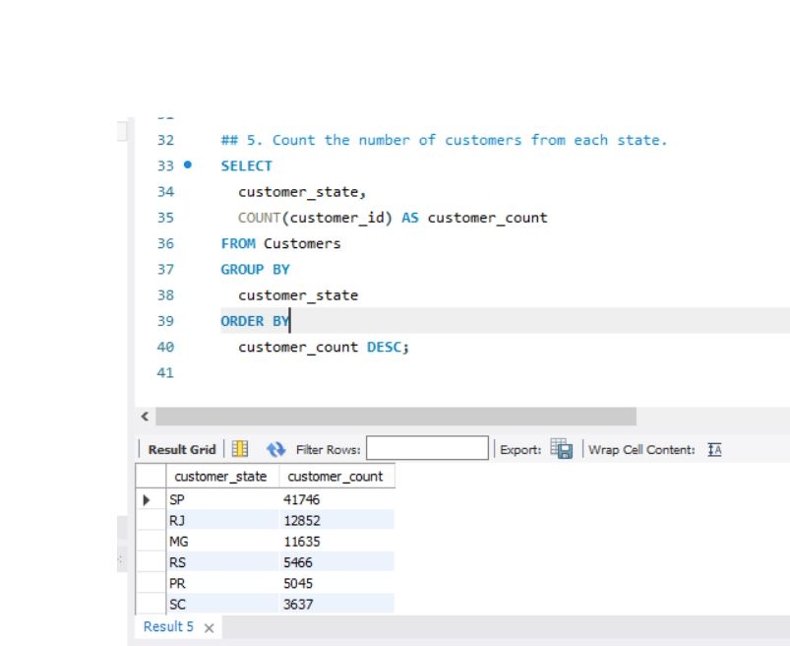
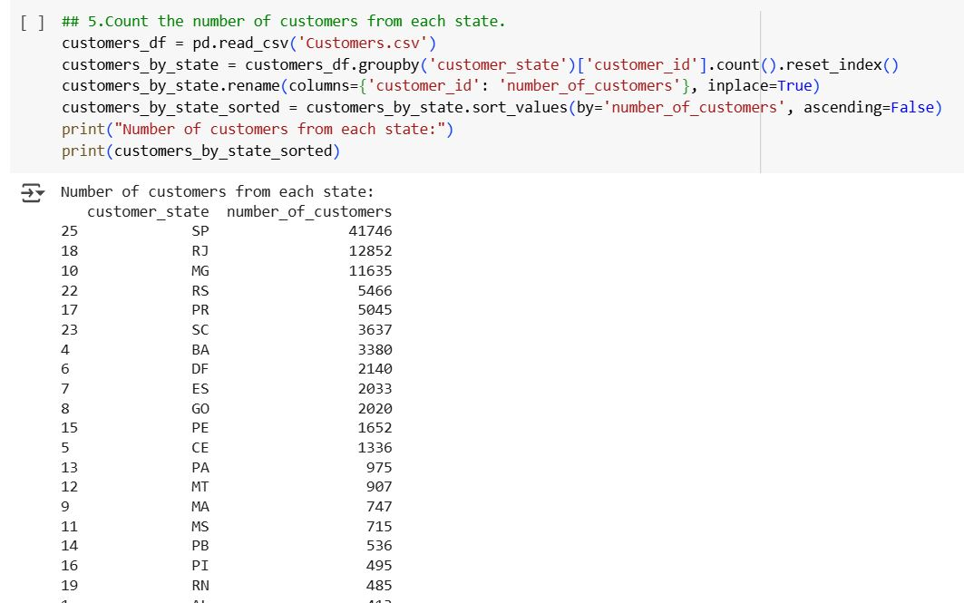
5. Count the number of customers from each state.

Slide 9
INTERMEDIATE PROBLEMS

Slide 10
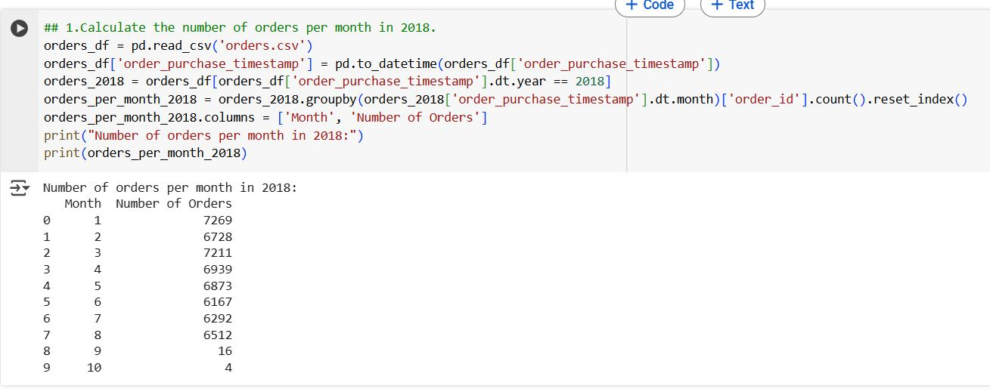
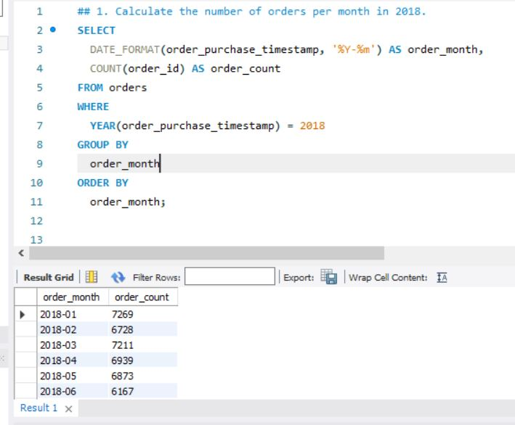
1. Calculate the number of orders per month in 2018.

Slide 11
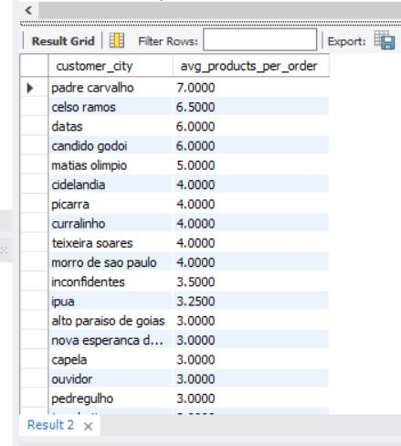
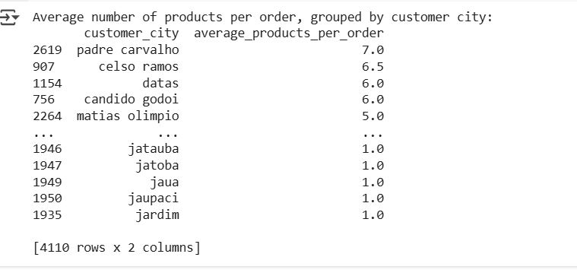
2. Find the average number of products per order. grouped by customer city.
Python code:
customers_df = pd.read_csv('Customers.csv')
orders_df = pd.read_csv('orders.csv')
order_items_df = pd.read_csv('order_items.csv')
orders_with_customers = pd.merge(orders_df, customers_df, on='customer_id')
merged_df = pd.merge(orders_with_customers, order_items_df, on='order_id')
products_per_order = merged_df.groupby(['customer_city', 'order_id']).size().reset_index(name='number_of_products')
average_products_per_city = products_per_order.groupby('customer_city')['number_of_products'].mean().reset_index()
average_products_per_city.rename(columns={'number_of_products': 'average_products_per_order'}, inplace=True)
average_products_per_city_sorted = average_products_per_city.sort_values(by='average_products_per_order', ascending=False)
print("Average number of products per order, grouped by customer city:")
print(average_products_per_city_sorted)
SQL Code :
WITH ProductsPerOrder AS ( SELECT order_id, COUNT(product_id) AS product_count
FROM order_items GROUP BY order_id ) SELECT T3.customer_city,
AVG(T1.product_count) AS avg_products_per_order FROM ProductsPerOrder AS T1
JOIN orders AS T2 ON T1.order_id = T2.order_id JOIN Customers AS T3 ON
T2.customer_id = T3.customer_id GROUP BY T3.customer_city ORDER BY
avg_products_per_order DESC;

Slide 12
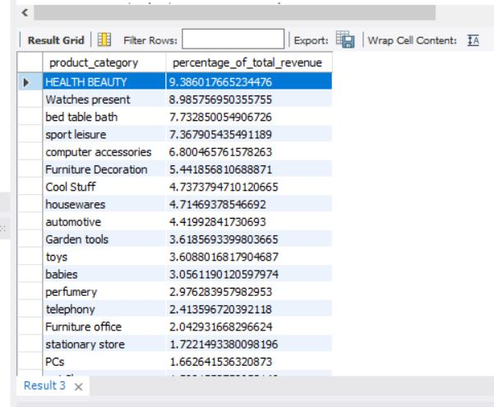
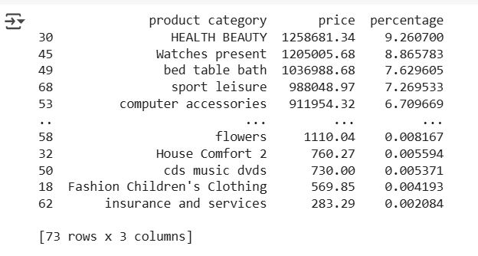
3. Calculate the percentage of total revenue contributed by each product category.
Python code :
order_items_df = pd.read_csv('order_items.csv')
products_df = pd.read_csv('products.csv')
merged_df = pd.merge(order_items_df, products_df, on='product_id')
total_revenue = merged_df['price'].sum()
revenue_per_category = merged_df.groupby('product category')['price'].sum().reset_index()
revenue_per_category['percentage'] = (revenue_per_category['price'] / total_revenue) * 100
revenue_percentage_sorted = revenue_per_category.sort_values(by='percentage', ascending=False)
print(revenue_percentage_sorted)
SQL code:
category. WITH CategoryRevenue AS ( SELECT T1.product_category, SUM(T2.price) AS
revenue FROM products AS T1 JOIN order_items AS T2 ON T1.product_id =
T2.product_id GROUP BY T1.product_category ) SELECT product_category, (revenue *
100.0) / ( SELECT SUM(revenue) FROM CategoryRevenue ) AS
percentage_of_total_revenue FROM CategoryRevenue ORDER BY
percentage_of_total_revenue DESC;

Slide 13
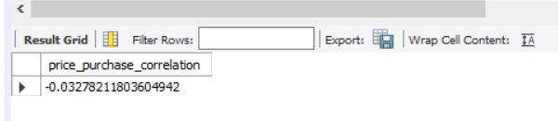
4. Identify the correlation between product price and the number of times a product has been purchased.
Python Code:
import pandas as pd
order_items_df = pd.read_csv('order_items.csv')
products_df = pd.read_csv('products.csv')
merged_df = pd.merge(order_items_df, products_df, on='product_id', how='inner')
product_summary =
merged_df.groupby('product_id').agg(number_of_purchases=('order_id’,
'count'),average_price=('price', 'mean')).reset_index()
correlation =
product_summary['number_of_purchases'].corr(product_summary['average_price'])
print(f"The correlation between product price and the number of times a product has been
purchased is: {correlation}")
SQL Code:
WITH ProductsPerOrder AS ( SELECT order_id, COUNT(product_id) AS
product_count FROM order_items GROUP BY order_id)SELECT T3.customer_city,
AVG(T1.product_count) AS avg_products_per_orderFROM ProductsPerOrder AS
T1JOIN orders AS T2 ON T1.order_id = T2.order_idJOIN Customers AS T3 ON
T2.customer_id = T3.customer_idGROUP BY T3.customer_cityORDER BY
avg_products_per_order DESC;

Slide 14
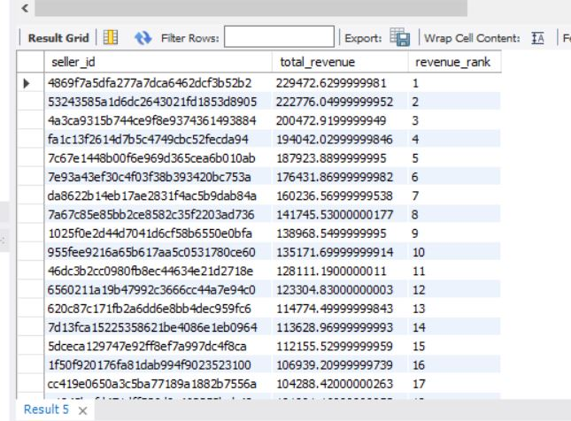
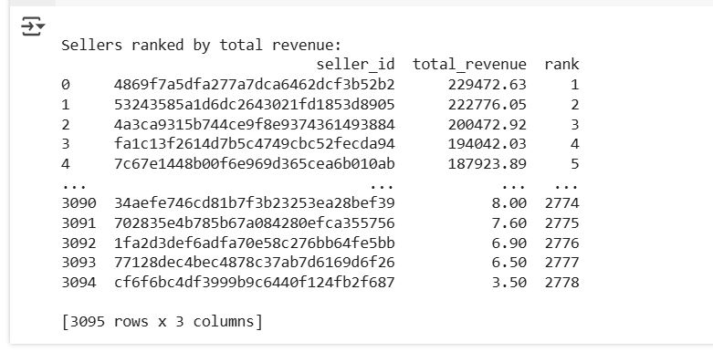
5. Calculate the total revenue generated by each seller and rank them by revenue.
Python Code:
order_items_df = pd.read_csv('order_items.csv')
revenue_per_seller =
order_items_df.groupby('seller_id')['price'].sum().reset_index()
revenue_per_seller.columns = ['seller_id', 'total_revenue']
ranked_sellers = revenue_per_seller.sort_values(by='total_revenue', ascending=False)
ranked_sellers['rank’] =
ranked_sellers['total_revenue'].rank(method='dense’,
ascending=False).astype(int)
ranked_sellers = ranked_sellers.reset_index(drop=True)
print("\nSellers ranked by total revenue:")
print(ranked_sellers)
SQL Code:
SELECT T1.seller_id, SUM(T2.price) AS total_revenue, RANK() OVER ( ORDER BY SUM(T2.price)
DESC ) AS revenue_rank FROM sellers AS T1 JOIN order_items AS T2 ON T1.seller_id =
T2.seller_id GROUP BY T1.seller_id ORDER BY revenue_rank;

Slide 15
ADVANCED PROBLEMS

Slide 16
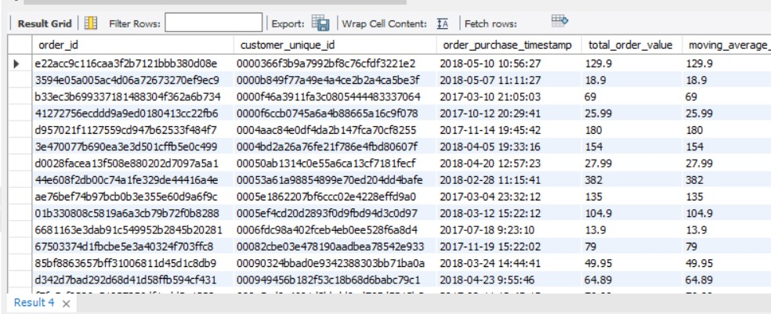
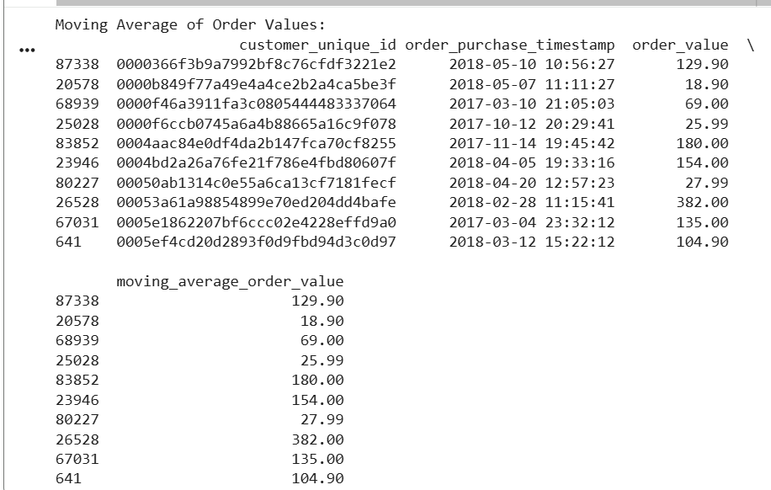
1. Calculate the moving average of order values for each customer over their order history.
Python Code:
import pandas as pd
orders_df = pd.read_csv('orders.csv')
order_items_df = pd.read_csv('order_items.csv')
customers_df = pd.read_csv('Customers.csv')
order_value_df = pd.merge(order_items_df, orders_df, on='order_id', how='left')
order_value_df = order_value_df.groupby('order_id').agg(order_value=('price', 'sum'),order_purchase_timestamp=('order_purchase_timestamp', 'first')).reset_index()
order_value_df = pd.merge(order_value_df, orders_df[['order_id', 'customer_id']], on='order_id', how='left')
order_value_df = pd.merge(order_value_df, customers_df, on='customer_id', how='left')
order_value_df.dropna(subset=['customer_unique_id'], inplace=True)
order_value_df['order_purchase_timestamp'] = pd.to_datetime(order_value_df['order_purchase_timestamp'])
order_value_df.sort_values(by=['customer_unique_id', 'order_purchase_timestamp'], inplace=True)
order_value_df['moving_average_order_value'] = order_value_df.groupby('customer_unique_id')['order_value'].transform(lambda x: x.rolling(window=2, min_periods=1).mean())
print("Moving Average of Order Values:")
print(order_value_df[['customer_unique_id', 'order_purchase_timestamp', 'order_value', 'moving_average_order_value']].head(10))
SQL Code:
WITH order_values AS ( SELECT t1.order_id, t1.order_purchase_timestamp,
t2.customer_unique_id, SUM(t3.price) AS total_order_value FROM orders
AS t1 JOIN Customers AS t2 ON t1.customer_id = t2.customer_id JOIN
order_items AS t3 ON t1.order_id = t3.order_id GROUP BY t1.order_id,
t1.order_purchase_timestamp, t2.customer_unique_id)SELECT order_id,
customer_unique_id, order_purchase_timestamp, total_order_value,
AVG(total_order_value) OVER ( PARTITION BY customer_unique_id ORDER BY
order_purchase_timestamp ROWS BETWEEN 1 PRECEDING AND CURRENT ROW )
AS moving_average_order_valueFROM order_valuesORDER BY
customer_unique_id, order_purchase_timestamp;

Slide 17
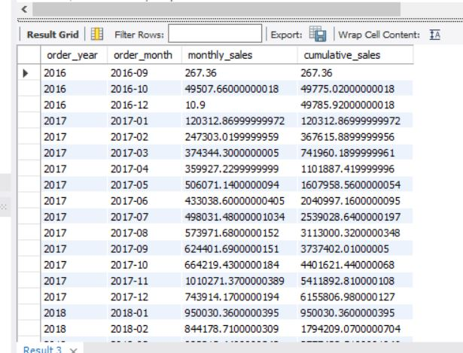
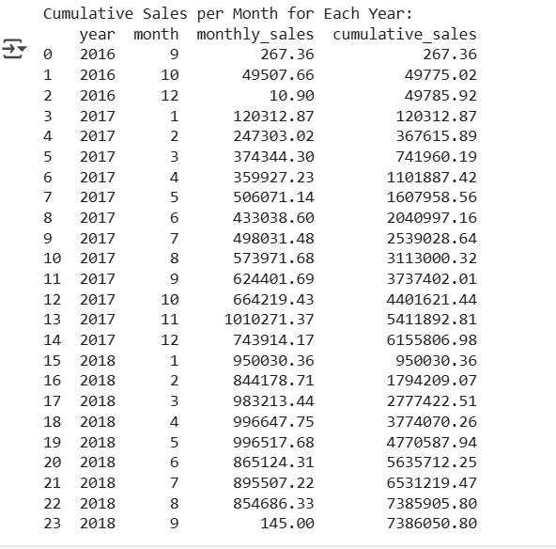
2. Calculate the cumulative sales per month for each year.
Python Code:
orders_df = pd.read_csv('orders.csv')
order_items_df = pd.read_csv('order_items.csv')
order_sales = order_items_df.groupby('order_id').agg(total_sales=('price', 'sum')).reset_index()
order_sales_with_date = pd.merge(orders_df[['order_id', 'order_purchase_timestamp']],order_sales,
on='order_id')
order_sales_with_date['order_purchase_timestamp'] =
pd.to_datetime(order_sales_with_date['order_purchase_timestamp'])
order_sales_with_date['year'] = order_sales_with_date['order_purchase_timestamp'].dt.year
order_sales_with_date['month'] = order_sales_with_date['order_purchase_timestamp'].dt.month
monthly_sales = order_sales_with_date.groupby(['year', 'month']).agg(monthly_sales=('total_sales’,
'sum')).reset_index()
monthly_sales = monthly_sales.sort_values(by=['year', 'month'])
monthly_sales['cumulative_sales'] = monthly_sales.groupby('year')['monthly_sales'].cumsum()
print("\nCumulative Sales per Month for Each Year:")
SQL Code:
WITH MonthlySales AS ( SELECT
DATE_FORMAT(T1.order_purchase_timestamp, '%Y') AS order_year,
DATE_FORMAT(T1.order_purchase_timestamp, '%Y-%m') AS order_month,
SUM(T2.price) AS monthly_sales FROM orders AS T1 JOIN order_items AS T2
ON T1.order_id = T2.order_id GROUP BY order_year, order_month ) SELECT
order_year, order_month, monthly_sales, SUM(monthly_sales) OVER (
PARTITION BY order_year ORDER BY order_month ) AS cumulative_sales FROM
MonthlySales ORDER BY order_year, order_month;

Slide 18
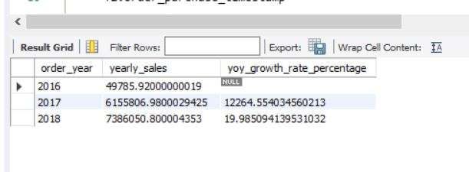
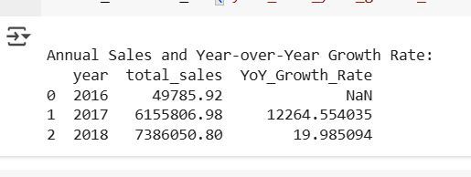
3. Calculate the year-over-year growth rate of total sales.
Python Code:
orders_df = pd.read_csv('orders.csv')
order_items_df = pd.read_csv('order_items.csv')
order_sales = order_items_df.groupby('order_id').agg(total_sales=('price', 'sum')).reset_index()
order_sales_with_date = pd.merge(orders_df[['order_id', 'order_purchase_timestamp']], order_sales, on='order_id')
order_sales_with_date['order_purchase_timestamp'] = pd.to_datetime(order_sales_with_date['order_purchase_timestamp'])
order_sales_with_date['year'] = order_sales_with_date['order_purchase_timestamp'].dt.year
annual_sales = order_sales_with_date.groupby('year')['total_sales'].sum().reset_index()
annual_sales['YoY_Growth_Rate'] = annual_sales['total_sales'].pct_change() * 100
print("\nAnnual Sales and Year-over-Year Growth Rate:")
print(annual_sales)
annual_sales.to_csv('year_over_year_growth_rate.csv', index=False)
SQL Code:
SELECT YEAR(T1.order_purchase_timestamp) AS order_year, SUM(T2.price) AS
yearly_sales FROM orders AS T1 JOIN order_items AS T2 ON T1.order_id =
T2.order_id GROUP BY order_year ) SELECT order_year, yearly_sales, (
(yearly_sales - LAG(yearly_sales) OVER ( ORDER BY order_year )) /
LAG(yearly_sales) OVER ( ORDER BY order_year ) ) * 100 AS
yoy_growth_rate_percentage FROM AnnualSales ORDER BY order_year;

Slide 19
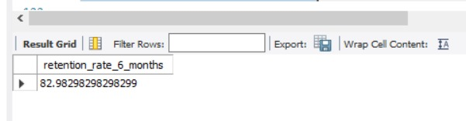
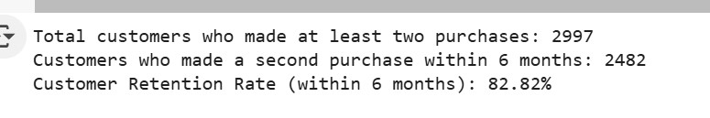
4. Calculate the retention rate of customers, defined as the percentage of customers who make another purchase within 6 months of their first purchase.
Python code:
import pandas as pd
from datetime import timedelta
orders_df = pd.read_csv('orders.csv')
customers_df = pd.read_csv('Customers.csv')
merged_df = pd.merge(orders_df, customers_df, on='customer_id', how='inner')
merged_df['order_purchase_timestamp'] = pd.to_datetime(merged_df['order_purchase_timestamp'])
merged_df.sort_values(by=['customer_unique_id', 'order_purchase_timestamp'], inplace=True)
purchase_dates = merged_df.groupby('customer_unique_id')['order_purchase_timestamp'].apply(list)
retained_customers_data = purchase_dates[purchase_dates.apply(len) > 1].reset_index()
retained_customers_data['first_purchase'] = retained_customers_data['order_purchase_timestamp'].apply(lambda x: x[0])
retained_customers_data['second_purchase'] = retained_customers_data['order_purchase_timestamp'].apply(lambda x: x[1])
retained_customers_data['time_to_second_purchase'] = retained_customers_data['second_purchase'] - retained_customers_data['first_purchase']
six_months = timedelta(days=180)
retained_count = (retained_customers_data['time_to_second_purchase'] <= six_months).sum()
total_retained_customers = len(retained_customers_data)
retention_rate = (retained_count / total_retained_customers) * 100
print(f"Total customers who made at least two purchases: {total_retained_customers}")
print(f"Customers who made a second purchase within 6 months: {retained_count}")
print(f"Customer Retention Rate (within 6 months): {retention_rate:.2f}%")
SQL Code:
WITH CustomerOrders AS ( SELECT T1.customer_unique_id,
T2.order_purchase_timestamp FROM Customers AS T1 JOIN orders AS T2 ON
T1.customer_id = T2.customer_id ), FirstPurchaseDates AS ( SELECT
customer_unique_id, MIN(order_purchase_timestamp) AS first_purchase_date
FROM CustomerOrders GROUP BY customer_unique_id ), RetainedCustomers AS (
SELECT DISTINCT T1.customer_unique_id FROM FirstPurchaseDates AS T1 JOIN
CustomerOrders AS T2 ON T1.customer_unique_id = T2.customer_unique_id
WHERE T2.order_purchase_timestamp > T1.first_purchase_date AND
T2.order_purchase_timestamp <= DATE_ADD(T1.first_purchase_date, INTERVAL 6
MONTH) ) SELECT ( ( SELECT COUNT(*) FROM RetainedCustomers ) * 100.0 ) / (
SELECT COUNT(*) FROM FirstPurchaseDates ) AS retention_rate_percentage;

Slide 20
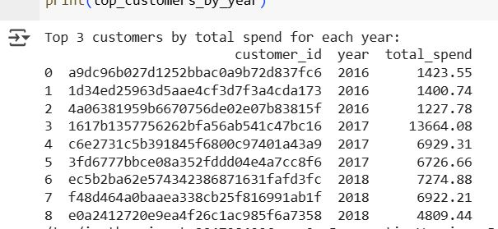
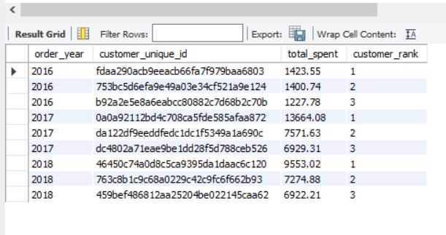
5. Identify the top 3 customers who spent the most money in each year.
Python Code :
orders_df = pd.read_csv('orders.csv')
payments_df = pd.read_csv('payments.csv')
df_merged = pd.merge(orders_df, payments_df, on='order_id')
df_merged['order_purchase_timestamp'] = pd.to_datetime(df_merged['order_purchase_timestamp'])
df_merged['year'] = df_merged['order_purchase_timestamp'].dt.year
customer_yearly_spend = df_merged.groupby(['customer_id', 'year'])['payment_value'].sum().reset_index()
customer_yearly_spend.columns = ['customer_id', 'year', 'total_spend']
top_customers_by_year = customer_yearly_spend.groupby('year').apply(lambda x:
x.sort_values(by='total_spend', ascending=False).head(3)).reset_index(drop=True)
print("Top 3 customers by total spend for each year:")
print(top_customers_by_year)
SQL Code :
WITH CustomerOrderSpending AS ( SELECT T1.order_id, SUM(T1.payment_value) AS
order_value FROM payments AS T1 GROUP BY T1.order_id ), CustomerAnnualSpending
AS ( SELECT YEAR(T2.order_purchase_timestamp) AS order_year,
T3.customer_unique_id, SUM(T1.order_value) AS total_spent FROM
CustomerOrderSpending AS T1 JOIN orders AS T2 ON T1.order_id = T2.order_id JOIN
Customers AS T3 ON T2.customer_id = T3.customer_id GROUP BY order_year,
T3.customer_unique_id ), RankedCustomers AS ( SELECT order_year,
customer_unique_id, total_spent, RANK() OVER ( PARTITION BY order_year ORDER BY
total_spent DESC ) AS customer_rank FROM CustomerAnnualSpending ) SELECT
order_year, customer_unique_id, total_spent, customer_rank FROM RankedCustomers
WHERE customer_rank <= 3 ORDER BY order_year, customer_rank

Slide 21
Recommendations
Customer Retention:
Introduce loyalty programs, subscription discounts, or cashback to improve repeat purchase rate.
Personalized product recommendations (using past purchase data) could increase retention.
Geographic Expansion:
Focus marketing on SP, RJ, MG since they contribute the bulk of sales.
But also design growth campaigns in RS, PR, SC where customer base is decent, but sales are relatively lower → untapped potential.
Product Strategy:
Push top categories (Health & Beauty, Watches, Bed/Bath) with targeted ads.
Bundle high-margin but less frequent categories (like electronics, computer accessories) with popular categories.
Payment Optimization:
Since ~50% of payments are installment-based, offering more flexible EMI options could drive higher order values.
Partnerships with banks/fintech's can reduce payment friction.
Seller Network:
Dependency is high on a few sellers. Encourage new seller onboarding from underrepresented states (e.g., Northern Brazil) to diversify.
Provide seller analytics dashboards to improve their sales performance.

Slide 22
Conclusion
The business shows strong YoY growth (20% in 2018) and a wide customer reach (4,119 cities) but suffers from very low customer retention (0%). Sales are highly concentrated in SP state and a few top sellers, which creates risk. To ensure long-term sustainability, the company should:
Build loyalty programs
Expand beyond SP into secondary states
Diversify seller & product portfolio.
With these steps, the platform can convert its large new customer base into repeat loyal buyers, ensuring sustainable revenue growth.

